Slide 1
Requirements Definition

Slide 2
Requirements Analysis & Specification Definitions
Requirements Analysis
  The process of studying and analyzing the customer and the user needs to arrive at a definition of software requirements.¹
Requirements Specification
  A document that clearly and precisely describes, each of the essential requirements (functions, performance, design constraint, and quality attributes) of the software and the external interfaces. Each requirement being defined in such a way that its achievement is capable of being objectively verified by a prescribed method; for example inspection, demonstration, analysis, or test.²

Slide 3
Requirements engineering
Requirements engineering is the process of establishing
the services that the customer requires from a system
the constraints under which it operates and is developed
Requirements
The descriptions of the system services and constraints
that are generated during the requirements engineering process

Slide 4
What is a requirement?
It may range from a high-level abstract statement of a service or of a system constraint to a detailed mathematical functional specification
This is inevitable as requirements may serve a dual function
  May be the basis for a bid for a contract - therefore must be open to interpretation
  May be the basis for the contract itself - therefore must be defined in detail
  Both these statements may be called requirements

Slide 5
Types of requirement
User requirements
  Statements in natural language plus diagrams of the services the system provides and its operational constraints. Written for customers
System requirements
  A structured document setting out detailed descriptions of the system services. Written as a contract between client and contractor
Software specification
  A detailed software description which can serve as a basis for a design or implementation. Written for developers

Slide 6
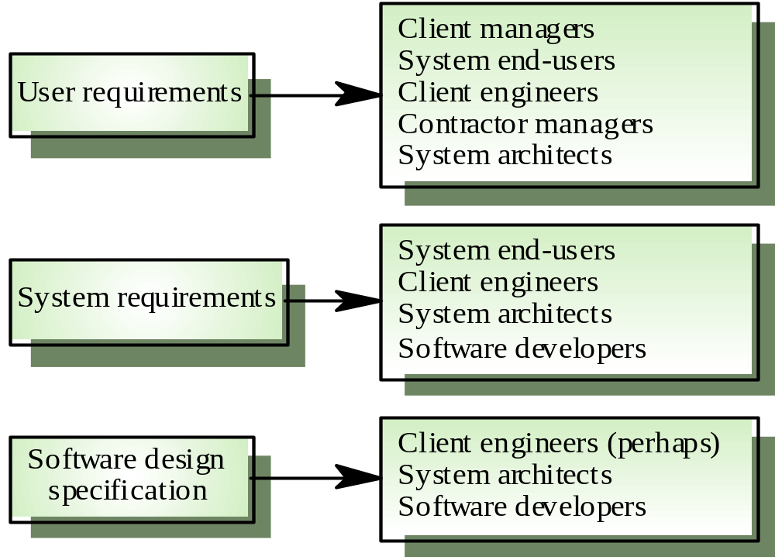
Requirements readers

Slide 7
Functional and non-functional requirements
Functional requirements
  Statements of services the system should provide, how the system should react to particular inputs and how the system should behave in particular situations.
Non-functional requirements
  constraints on the services or functions offered by the system such as timing constraints, constraints on the development process, standards, etc.
Domain requirements
  Requirements that come from the application domain of the system and that reflect characteristics of that domain

Slide 8
Functional Requirements
Describe functionality or system services
Depend on the type of software, expected users and the type of system where the software is used
Functional user requirements may be high-level statements of what the system should do BUT functional system requirements should describe the system services in detail

Slide 9
Requirements imprecision
Problems arise when requirements are not precisely stated
Ambiguous requirements may be interpreted in different ways by developers and users
Consider the term ‘appropriate viewers’
  User intention - special purpose viewer for each different document type
  Developer interpretation - Provide a text viewer that shows the contents of the document

Slide 10
Requirements completeness and consistency
In principle requirements should be both complete and consistent
Complete
  They should include descriptions of all facilities required
Consistent
  There should be no conflicts or contradictions in the descriptions of the system facilities
In practice, it is very difficult or impossible to produce a complete and consistent requirements document

Slide 11
Non-functional requirements
Define system properties and constraints e.g. reliability, response time and storage requirements. Constraints are I/O device capability, system representations, etc.
Process requirements may also be specified mandating a particular CASE system, programming language or development method
Non-functional requirements may be more critical than functional requirements. If these are not met, the system is useless

Slide 12
Non-functional classifications
Product requirements
  Requirements which specify that the delivered product must behave in a particular way e.g. execution speed, reliability, etc.
Organisational requirements
  Requirements which are a consequence of organisational policies and procedures e.g. process standards used, implementation requirements, etc.
External requirements
  Requirements which arise from factors which are external to the system and its development process e.g. interoperability requirements, legislative requirements, etc.

Slide 13
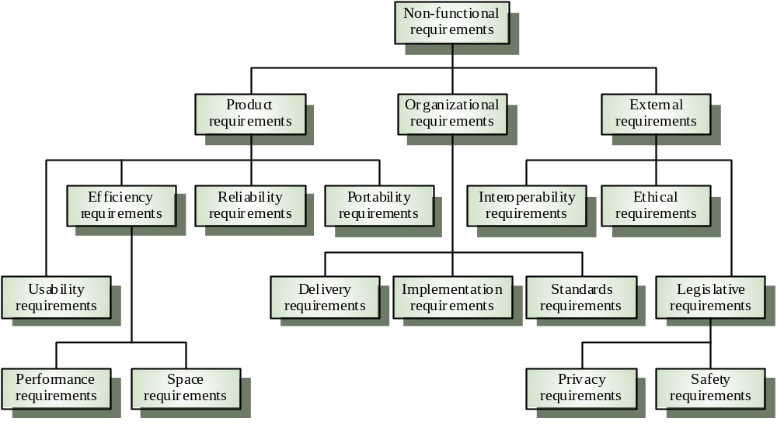
Non-functional requirement types

Slide 14
Goals and requirements
Non-functional requirements may be very difficult to state precisely and imprecise requirements may be difficult to verify.
Goal
  A general intention of the user such as ease of use
Verifiable non-functional requirement
  A statement using some measure that can be objectively tested
Goals are helpful to developers as they convey the intentions of the system users

Slide 15
Examples
A system goal
  The system should be easy to use by experienced controllers and should be organised in such a way that user errors are minimised.
A verifiable non-functional requirement
  Experienced controllers shall be able to use all the system functions after a total of two hours training. After this training, the average number of errors made by experienced users shall not exceed two per day.

Slide 16
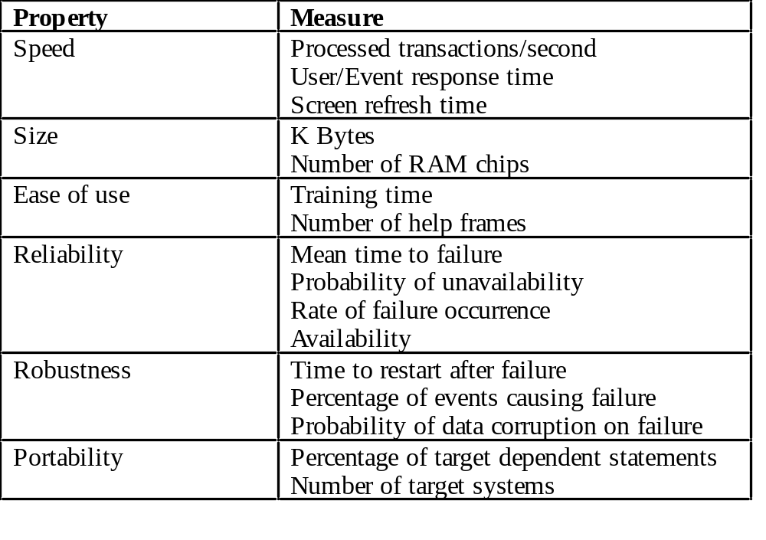
Requirements measures

Slide 17
Requirements interaction
Conflicts between different non-functional requirements are common in complex systems
Spacecraft system
  To minimise weight, the number of separate chips in the system should be minimised
  To minimise power consumption,
  lower power chips should be used
  However, using low power chips
  may mean that more chips have
  to be used.
  Which is the most critical requirement?

Slide 18
Domain requirements
Derived from the application domain and describe system characteristics and features that reflect the domain
May be new functional requirements, constraints on existing requirements or define specific computations
If domain requirements are not satisfied, the system may be unworkable

Slide 19
Domain requirements problems
Understandability
  Requirements are expressed in the language of the application domain
  This is often not understood by software engineers developing the system
Implicitness
  Domain specialists understand the area so well that they do not think of making the domain requirements explicit

Slide 20
User requirements
Should describe functional and non-functional requirements so that they are understandable by system users who don’t have detailed technical knowledge
User requirements are defined using natural language, tables and diagrams

Slide 21
Problems with natural language
Lack of clarity
  Precision is difficult without making the document difficult to read
Requirements confusion
  Functional and non-functional requirements tend to be mixed-up
Requirements amalgamation
  Several different requirements may be expressed together

Slide 22
Guidelines for writing requirements
Invent a standard format and use it for all requirements
Use language in a consistent way. Use
shall for mandatory requirements,
should for desirable requirements
Use text highlighting to identify key parts of the requirement
Avoid the use of computer jargon !!!

Slide 23
System requirements
– More detailed specifications of user requirements
Serve as a basis for designing the system
May be used as part of the system contract
System requirements may be expressed using system models

Slide 24
Requirements and design
In principle, requirements should state what the system should do and the design should describe how it does this
In practice, requirements and design are inseparable
  A system architecture may be designed to structure the requirements
  The system may inter-operate with other systems that generate design requirements
  The use of a specific design may be a domain requirement

Slide 25
Problems with NL specification
Ambiguity
  The readers and writers of the requirement must interpret the same words in the same way. NL is naturally ambiguous so this is very difficult
Over-flexibility
  The same thing may be said in a number of different ways in the specification
Lack of modularisation
  NL structures are inadequate to structure system requirements

Slide 26
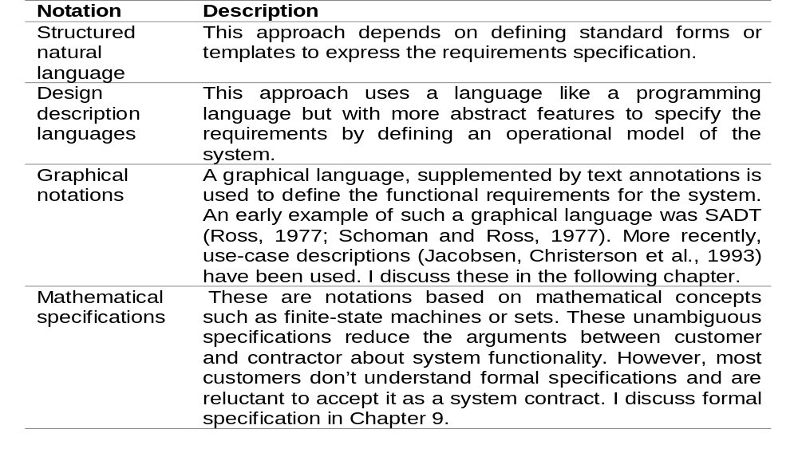
Alternatives to NL specification

Slide 27
Structured language specifications
A limited form of natural language may be used to express requirements
This removes some of the problems resulting from ambiguity and flexibility and imposes a degree of uniformity on a specification
Often best supported using a forms-based approach
Special-purpose forms where designed to describe the input, output and functions of a software system

Slide 28
Sequence diagrams
These show the sequence of events that take place during some user interaction with a system.
You read them from top to bottom to see the order of the actions that take place.

Slide 29
Interface specification
Most systems must operate with other systems and the operating interfaces must be specified as part of the requirements
Three types of interface may have to be defined
  Procedural interfaces
  Data structures that are exchanged
  Data representations
Formal notations are an effective technique for interface specification

Slide 30
The requirements document
The requirements document is the official statement of what is required of the system developers
Should include both a definition and a specification of requirements
It is NOT a design document. As far as possible, it should set of WHAT the system should do rather than HOW it should do it

Slide 31
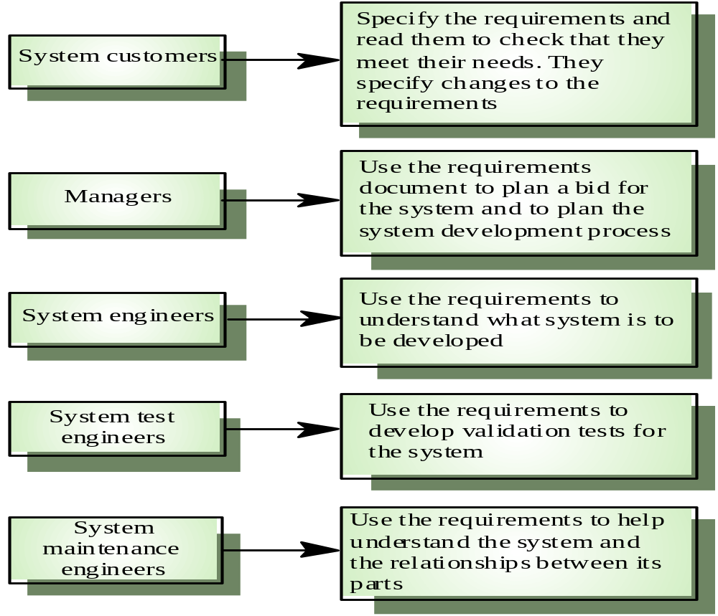
Users of a requirements document

Slide 32
Requirements document requirements
Specify external system behaviour
Specify implementation constraints
Easy to change
Serve as reference tool for maintenance
Record forethought about the life cycle of the system i.e. predict changes
Characterise responses to unexpected events

Slide 33
IEEE requirements standard
Introduction
General description
Specific requirements
Appendices
Index
This is a generic structure that must be instantiated for specific systems

Slide 34
Requirements document structure
Introduction
Glossary
User requirements definition
System architecture
System requirements specification
System models
System evolution
Appendices
Index

